Slide 1
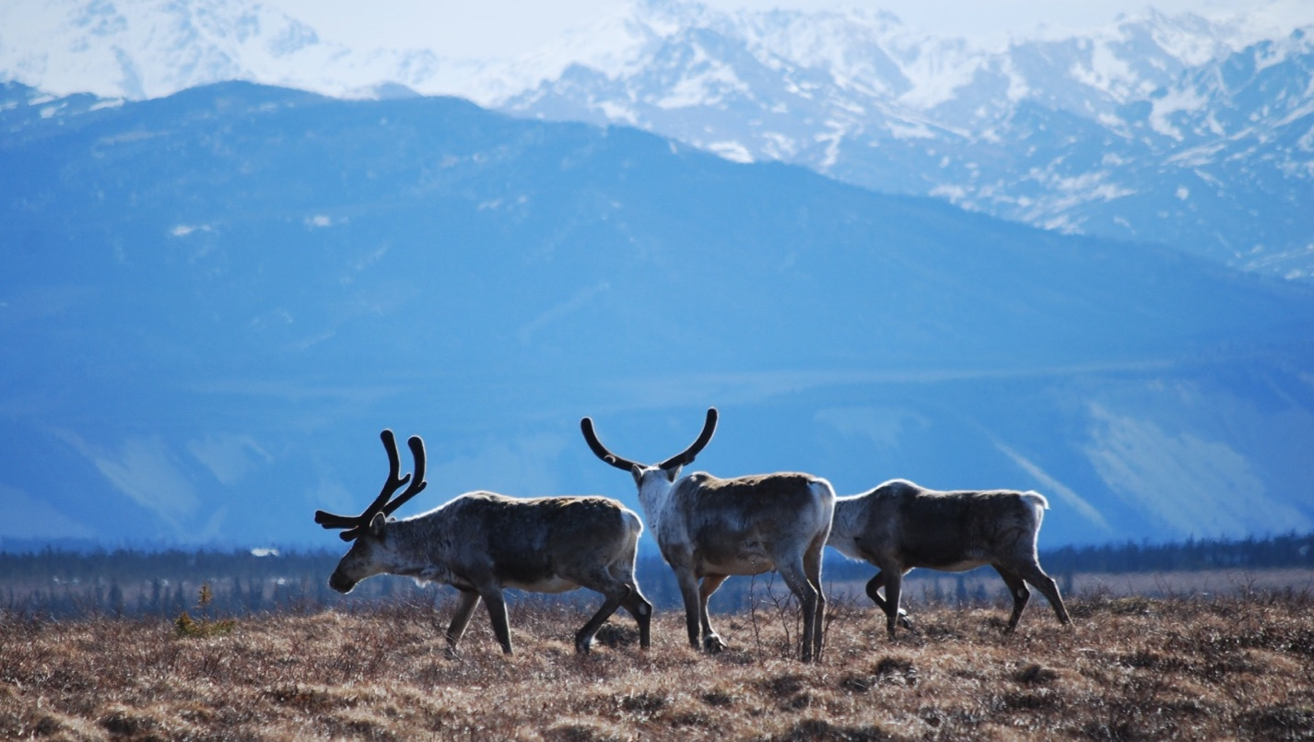
Arctic Boreal Vulnerability Experiment (ABoVE)
2019 ABoVE Airborne Flights
6 July 2019 (DOY 187)
AVIRIS-NG: Ivotuk – Barrow – Atqasuk
Charles Miller, Deputy Science Lead
Jet Propulsion Laboratory, California Institute of Technology
and the ABoVE Science Team For Hank Margolis, Mike Falkowski, Bruce Tagg, Jack Kaye
NASA HQ
2019

Slide 2
6 July 2019/DOY 187 Ivotuk – Barrow – Atqasuk
Daily Status:
AVIRIS-NG / Dynamic Aviation B-200 (N53W)
REPORT DATE: 6 July 2019
Current Status of Aircraft: GREEN
Current Status of AVIRIS: GREEN
Current Deployment Location: Fairbanks AK (PAFA)
Crew: S Wilson (PIC), C McCann, M Eastwood, L Rios
Science Planning: A Thorpe
Data Processing: W Olsen-Duvall
Instrument Manager: M Eastwood
Instrument PI: R Green
Science Lead: C Miller

Slide 3
6 July 2019/DOY 187 Ivotuk – Barrow – Atqasuk
Daily Summary:
Mostly clear with some high cirrus
Coastal fog and low clouds absent
NEON AOP also operating at Barrow today
Best Barrow area data yet recorded by ABoVE

Slide 4
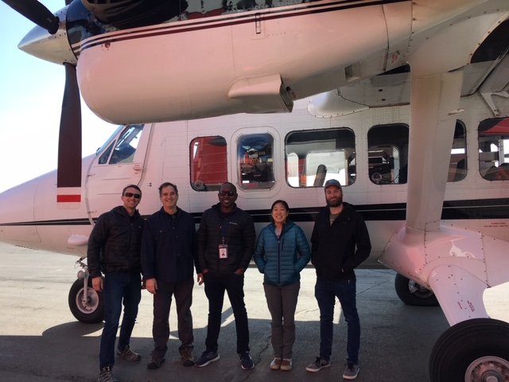
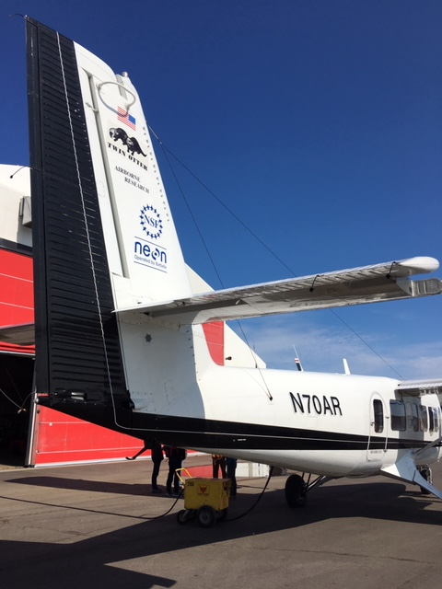
6 July 2019/DOY 187 Ivotuk – Barrow – Atqasuk
Notes:
AVIRIS & NEON teams in Barrow

Slide 5
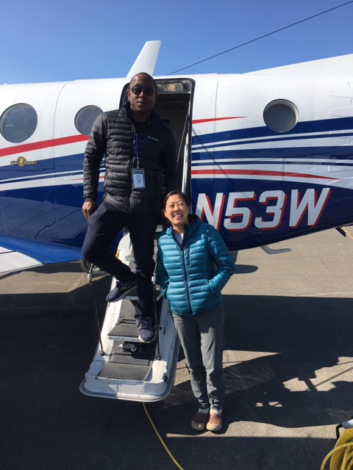
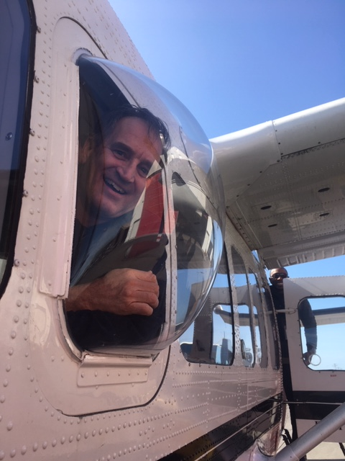
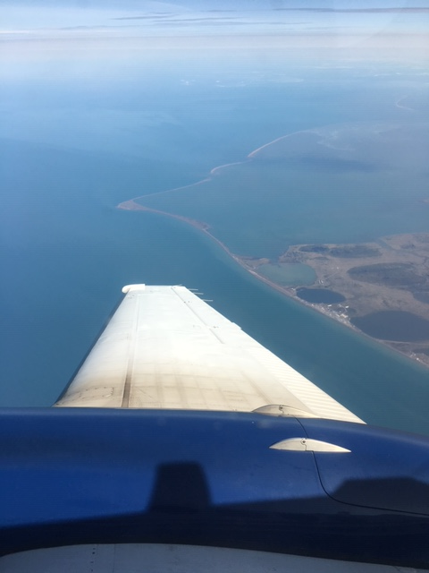
6 July 2019/DOY 187 Ivotuk – Barrow – Atqasuk

Slide 6
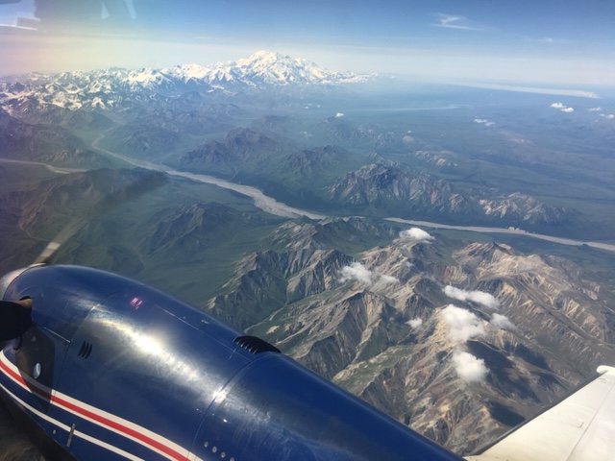
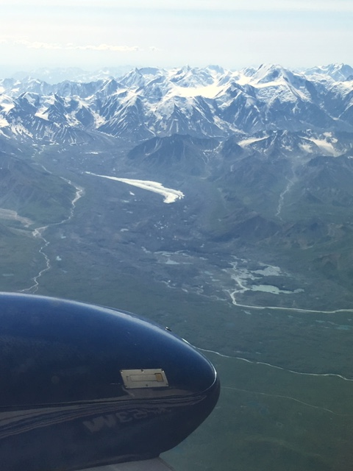
6 July 2019/DOY 187 Ivotuk – Barrow – Atqasuk

Slide 7
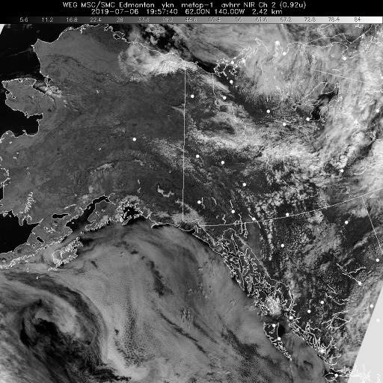
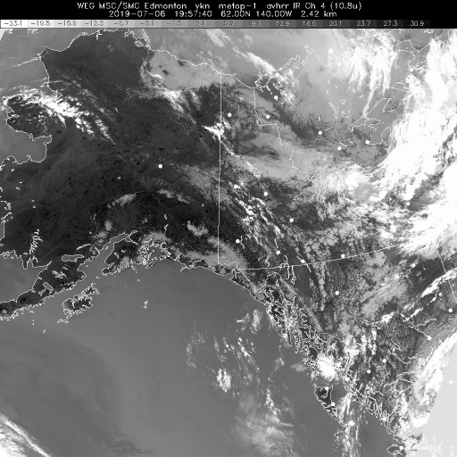
6 July 2019/DOY 187 Ivotuk – Barrow – Atqasuk
Vis 1957Z
IR 1957Z
Notes:
Some high cirrus, but no low level couds along the Ivotuk – Atqasuk – Barrow corridor. No coastal fog!

Slide 8
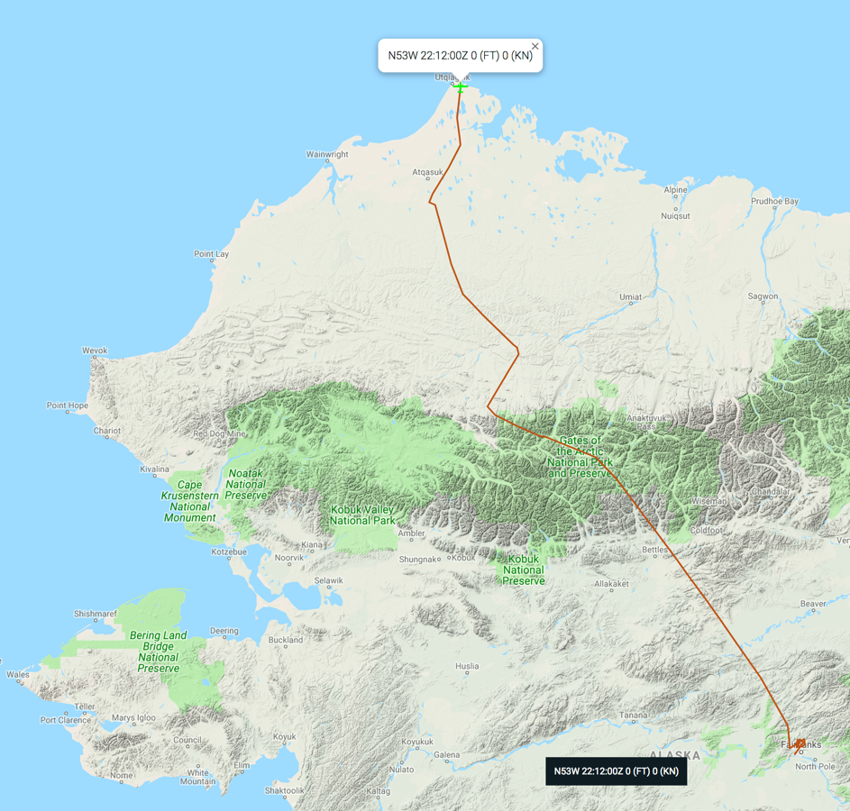
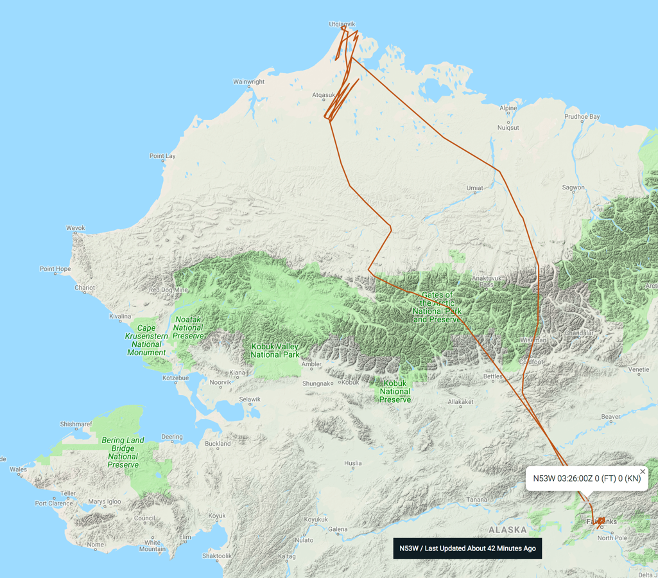
6 July 2019/DOY 187 Ivotuk – Barrow – Atqasuk
Leg 1
Leg 2
As-Flown Lines

Slide 9
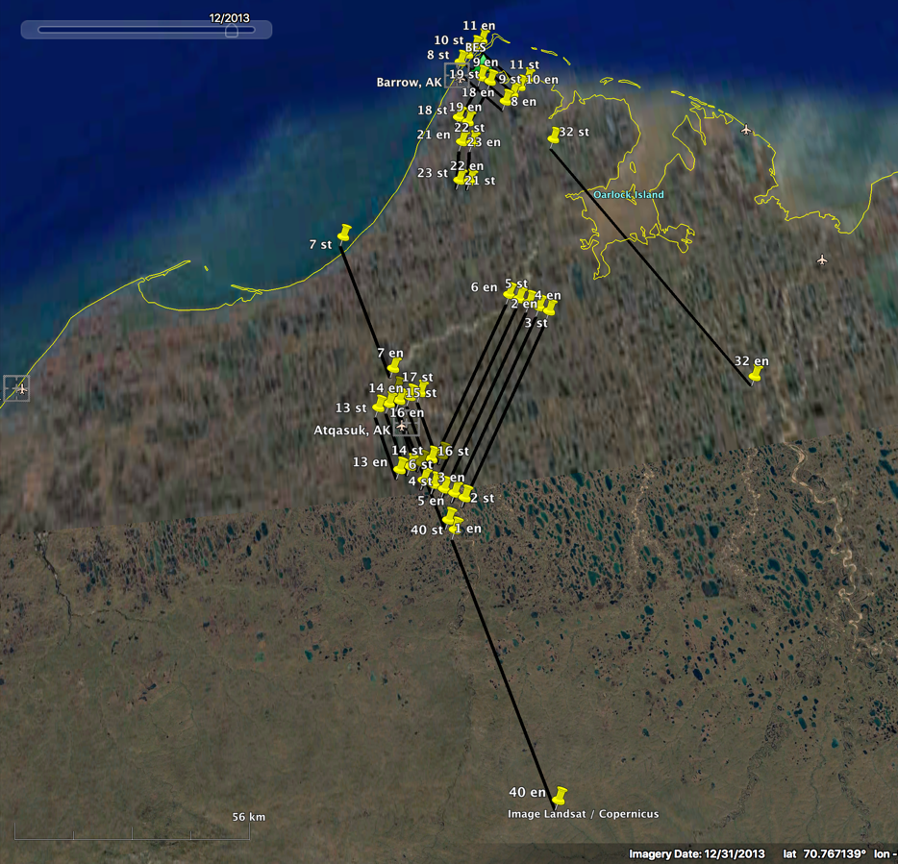
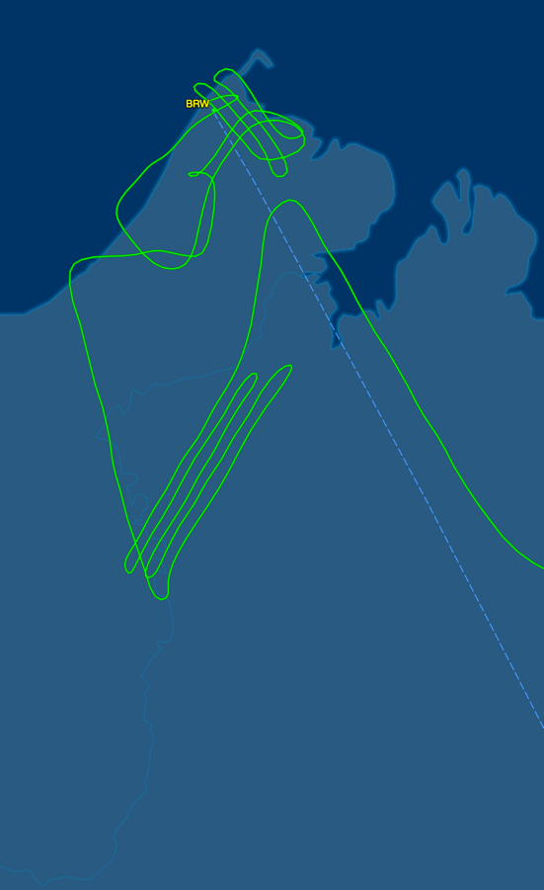
6 July 2019/DOY 187 Ivotuk – Barrow – Atqasuk
Barrow - Atqasuk Area
Planned Flight Lines
Barrow - Atqasuk Area
As-Flown Lines

Slide 10
6 July 2019/DOY 187 Ivotuk – Barrow – Atqasuk
AVIRIS-NG Quick-look products
https://avirisng.jpl.nasa.gov/cgi/flights.cgi?step=view_flightlog&flight_id=ang20190706t
A. Line AB_CH4_L002_FL072 , ang20190706t191924_geo : Fairbanks area; Big Trail Lake
B. Line AB_CH4_L002_FL072 , ang20190706t192454_geo : Fairbanks area; Big Trail Lake
A
B
A. 2 km altitude sampling
B. Repeat
Notes:
7/19/19 Review
Light cirrus/light smoke according to the flight log
GREEN
GREEN

Slide 11
6 July 2019/DOY 187 Ivotuk – Barrow – Atqasuk
AVIRIS-NG Quick-look products
https://avirisng.jpl.nasa.gov/cgi/flights.cgi?step=view_flightlog&flight_id=ang20190706t
A. Line AB_CH4_L001_FL183 , ang20190706t193356_geo : Goldstream Valley/Fairbanks area; Big Trail Lake
B. Line AVng_357A-357Z_FL189 , ang20190706t210739_geo : Ivotuk
A
B
A. Normal 6 km altitude sampling
B. Ivotuk airstrip seen at end of swath
Notes:
7/19/19 Review
Green/Yellow – a few clouds; flight log lists light cirrus/light smoke
GREEN

Slide 12
6 July 2019/DOY 187 Ivotuk – Barrow – Atqasuk
AVIRIS-NG Quick-look products
https://avirisng.jpl.nasa.gov/cgi/flights.cgi?step=view_flightlog&flight_id=ang20190706t
A. Line AVng_391A-391Z_FL177 , ang20190706t213057_geo : Atqasuk area
B. Line Atqasuk_L005_FL176 , ang20190706t214402_geo : Atqasuk grid
A
B
A. Greening observed; aquamarine colored lake in middle of scan
B. Mix of greening and areas still saturated and brown – window beginning to fog according to flight log
Notes:
7/19/19 Review
GREEN
GREEN

Slide 13
6 July 2019/DOY 187 Ivotuk – Barrow – Atqasuk
AVIRIS-NG Quick-look products
https://avirisng.jpl.nasa.gov/cgi/flights.cgi?step=view_flightlog&flight_id=ang20190706t
A. Line SukokLake_L001_FL175 , ang20190706t233606_geo : Sukok Lake
B. Line PipeLake_L002_FL175 , ang20190706t233851_geo : Pipeline Lake
A
B
A. Active lake biology
B. Differing lake productivity
Notes:
7/19/19 Review
Flight Log: Team landed, defogged window and took off again for acquisitions
GREEN
GREEN

Slide 14
6 July 2019/DOY 187 Ivotuk – Barrow – Atqasuk
AVIRIS-NG Quick-look products
https://avirisng.jpl.nasa.gov/cgi/flights.cgi?step=view_flightlog&flight_id=ang20190706t
A. Line Barrow_L001_FL175 , ang20190706t234547_geo : Barrow grid
B. Line Barrow_L002_FL175 , ang20190706t235120_geo : Barrow grid
A
B
A. Barrow airport seen on left hand edge
B. Arctic Ocean, Barrow infrastructure – best ABoVE imagery of Barrow area
Notes:
7/19/19 Review
GREEN
GREEN

Slide 15
6 July 2019/DOY 187 Ivotuk – Barrow – Atqasuk
AVIRIS-NG Quick-look products
https://avirisng.jpl.nasa.gov/cgi/flights.cgi?step=view_flightlog&flight_id=ang20190707t
A. Line Barrow_L004_FL175 , ang20190707t000208_geo : Barrow grid
B. Line PipeLake_L001_FL175 , ang20190707t000910_geo : Pipeline Lake
A
B
A. Amazing imagery of Admiralty Bay
B. Brilliant imagery
Notes:
Quick Look for Barrow_L003 in process
7/19/19 Review
GREEN
GREEN

Slide 16
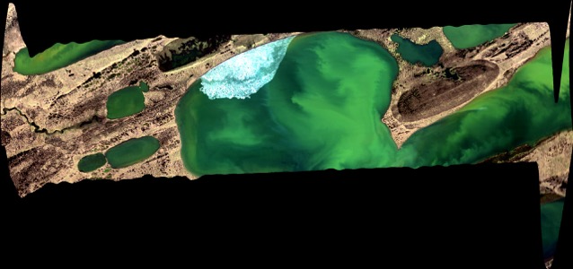
6 July 2019/DOY 187 Ivotuk – Barrow – Atqasuk
AVIRIS-NG Quick-look products
https://avirisng.jpl.nasa.gov/cgi/flights.cgi?step=view_flightlog&flight_id=ang20190707t
A. Line SukokLake_L002_FL175 , ang20190707t001434_geo : Sukok Lake
B. Line AVng_393A-393Z_FL175 , ang20190707t002307_geo : Transect
A
B
A. Ice still observed attached to lakeshore
B. Transect: Arctic ocean towards Atqasuk area
Notes:
7/19/19 Review
GREEN
GREEN – flight log records cirrus overhead

Slide 17
6 July 2019/DOY 187 Ivotuk – Barrow – Atqasuk
AVIRIS-NG Quick-look products
https://avirisng.jpl.nasa.gov/cgi/flights.cgi?step=view_flightlog&flight_id=ang20190707t
A. Line AVng_384A-384Z_FL175 , ang20190707t002939_geo : Atqasuk
B. Line Atqasuk_L001_FL176 , ang20190707t003638_geo: Atqasuk grid
A
B
A. Atqasuk village seen at left hand edge of image
B. Many, varied lakes in Atqasuk area
Notes:
7/19/19 Review
GREEN
GREEN

Slide 18
6 July 2019/DOY 187 Ivotuk – Barrow – Atqasuk
AVIRIS-NG Quick-look products
https://avirisng.jpl.nasa.gov/cgi/flights.cgi?step=view_flightlog&flight_id=ang20190707t
A. Line Atqasuk_L002_FL176 , ang20190707t004725_geo : Atqasuk grid
B. Line Atqasuk_L003_FL176 , ang20190707t005706_geo : Atqasuk grid
A
B
A. Many, varied lakes in Atqasuk area
B. Many, varied lakes in Atqasuk area
Notes:
7/19/19 Review
GREEN
GREEN

Slide 19
6 July 2019/DOY 187 Ivotuk – Barrow – Atqasuk
AVIRIS-NG Quick-look products
https://avirisng.jpl.nasa.gov/cgi/flights.cgi?step=view_flightlog&flight_id=ang20190707t
A. Line Atqasuk_L004_FL176 , ang20190707t010559_geo : Atqasuk grid
B. Line Atqasuk_L005_FL176 , ang20190707t011602_geo : Atqasuk grid
A
B
A. Many, varied lakes in Atqasuk area
B. Many, varied lakes in Atqasuk area
Notes:
7/19/19 Review
GREEN
GREEN

Slide 20
6 July 2019/DOY 187 Ivotuk – Barrow – Atqasuk
AVIRIS-NG Quick-look products
https://avirisng.jpl.nasa.gov/cgi/flights.cgi?step=view_flightlog&flight_id=ang20190707t
A. Line AVng_392A-392Z_FL175 , ang20190707t013009_geo : Lake Tusikovak, long transect SE of Barrow
A
B
A. CALM site and large lake
Notes:
7/19/19 Review
GREEN

Slide 21
6 July 2019/DOY 187 Ivotuk – Barrow – Atqasuk
AVIRIS-NG Quick-look products
https://avirisng.jpl.nasa.gov/cgi/flights.cgi?step=view_flightlog&flight_id=ang20190707t
A. Line Avng_383A-383B_FL179 , ang20190707t020232_geo : Anauktuvuk River Fire Scar, long transect part 1
B. Line AVng_383B-383Z_FL187 , ang20190707t021158_geo : Anauktuvuk River Fire Scar long transect part 2
A
B
A. Looking for disturbance
B. Many, varied lakes in Atqasuk area
Notes:
7/19/19 Review
GREEN
Yellow – flight log says late start – not full coverage; quality = GREEN

Slide 22
6 July 2019/DOY 187 Ivotuk – Barrow – Atqasuk
AVIRIS-NG Quick-look products
https://avirisng.jpl.nasa.gov/cgi/flights.cgi?step=view_flightlog&flight_id=ang20190707t
A. Line AVng_335D-335Z_FL190 , ang20190707t023526_geo : Coldfoot-Wiseman
B. Line AB_CH4_L002_FL072 , ang20190707t032100_geo : Fairbanks area; Big Trail Lake
A
B
A. Some cloud interference
B. Low altitude, high spatial resolution – compare to image from beginning of the day
Notes:
7/19/19 Review
GREEN
YELLOW – hazy; Flight log: high clouds, low smoke

Slide 23
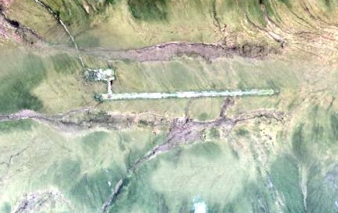
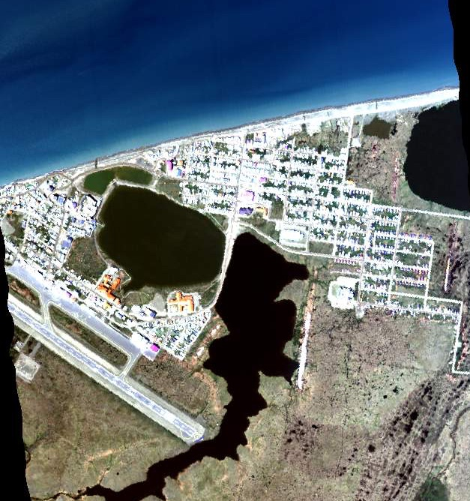
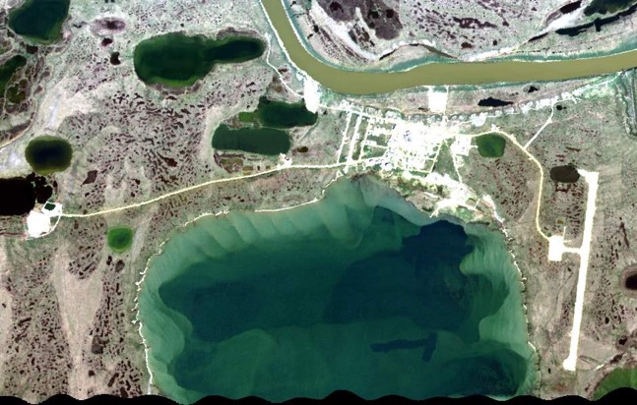
6 July 2019/DOY 187 Ivotuk – Barrow – Atqasuk
Ivotuk
Atqasuk
Barrow

Slide 24
Backup

Slide 25
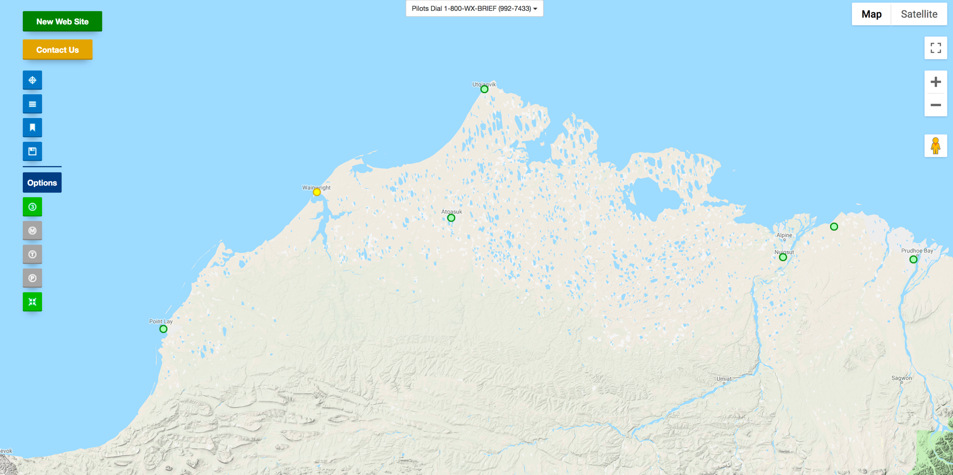
FAA Camera Locations

Slide 26
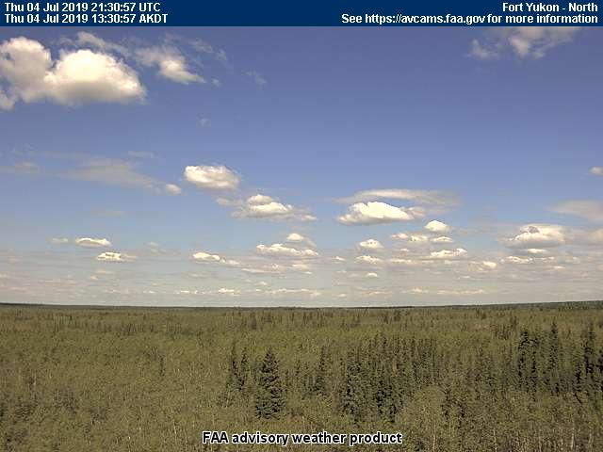
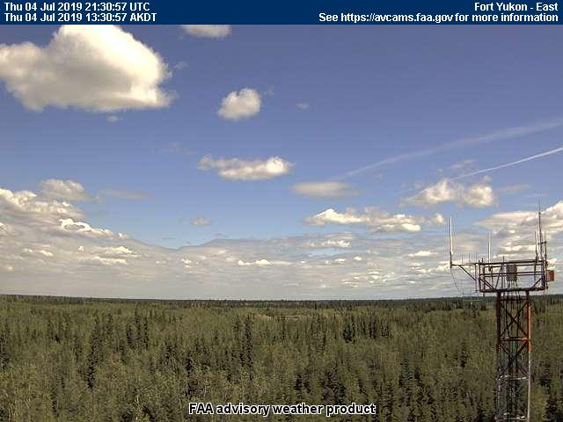
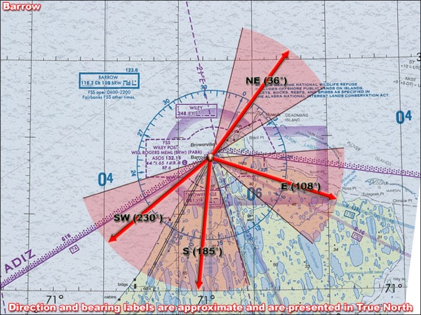
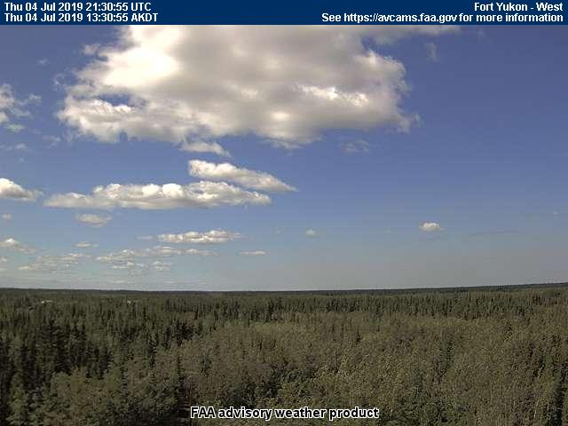
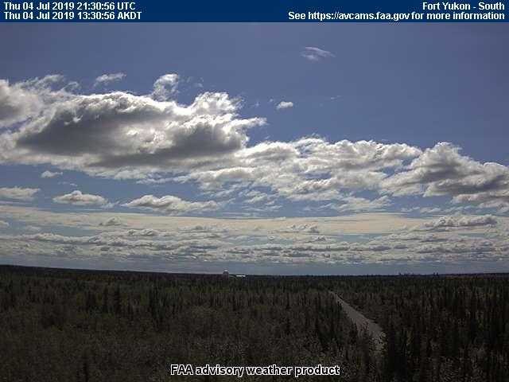
6 July 2019/DOY 187 Ivotuk – Barrow – Atqasuk
Barrow – 1330 AKDT/2130 UTC
Northeast
East
Southwest
South

Slide 27
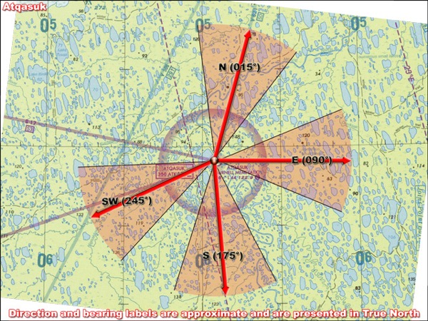
6 July 2019/DOY 187 Ivotuk – Barrow – Atqasuk
Atqasuk – 1330 AKDT/2130 UTC
North
East
Southwest
South

Slide 28
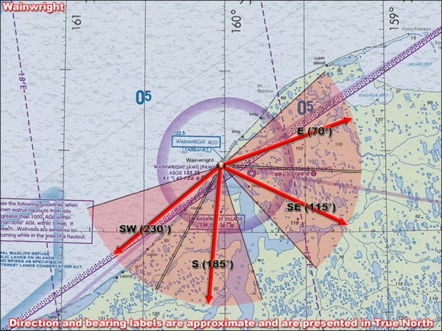
6 July 2019/DOY 187 Ivotuk – Barrow – Atqasuk
Wainwright – 1330 AKDT/2130 UTC
East
Southeast
Southwest
South

